Slide 1




Presented by Pranay Ulhas
Stock Price Gap Prediction with Deep Learning
Supervised by Dr. Vitaliy Milke
SSID - 2293112

Slide 2
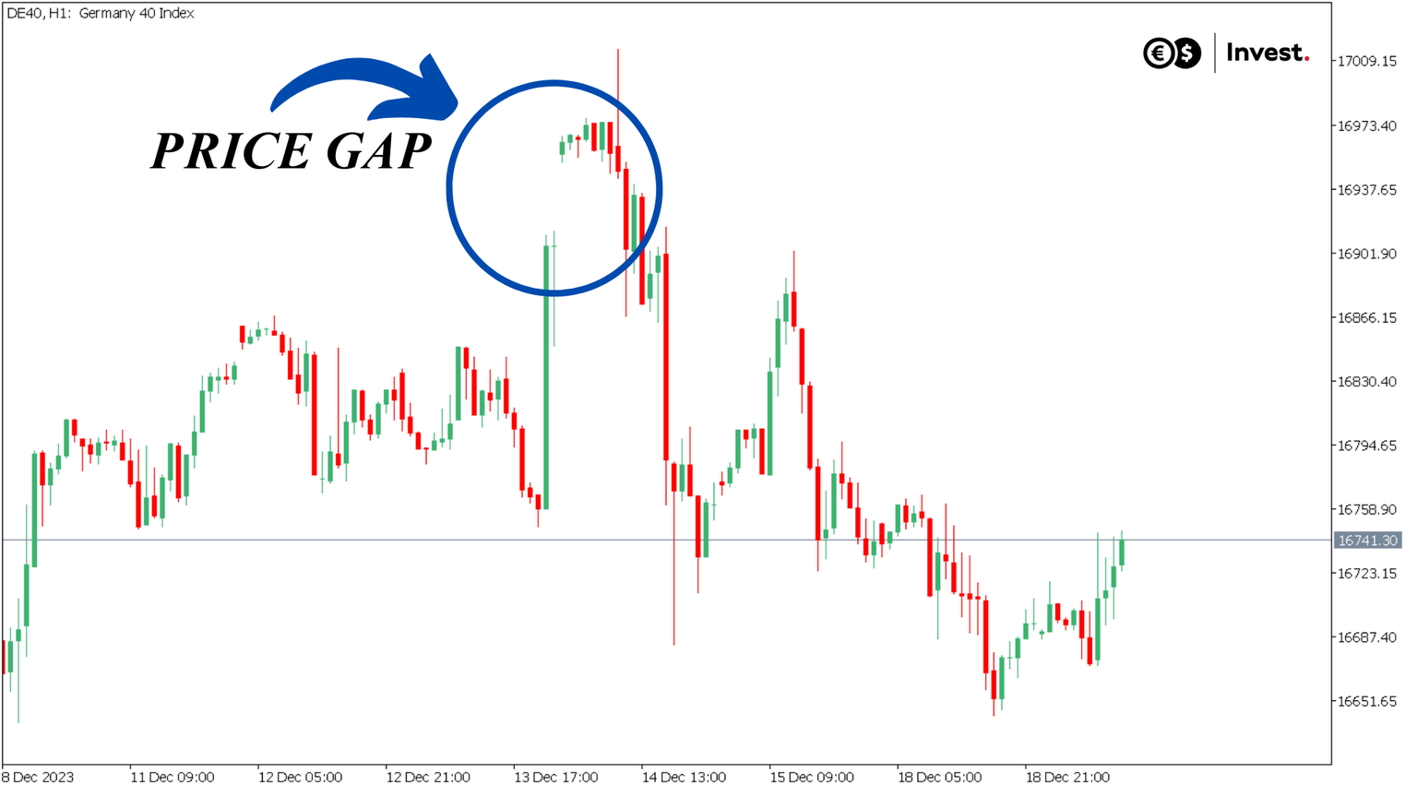
Introduction
Stock Price Gaps:
Gaps occur when a stock’s opening price is significantly higher or lower than its previous closing price.
These gaps can arise due to after-hours news, earnings reports, or major market events, leading to sharp movements in stock prices.
Understanding and predicting these gaps is crucial for traders, as they present opportunities for profit but also pose risks.

Slide 3
Importance for Trading Strategies:
Predicting whether the price gap will close or widen can help traders make more informed decisions, improve risk management, and optimize returns.
Stock price gaps are key indicators in day trading and swing trading, where market timing is critical.

Slide 4
Objective:
Goal of the Project:
Develop a model to predict stock price gaps for Apple Inc. (AAPL) using time series data from the AAPL/USD currency pair.
Use advanced deep learning method to understand and predict the complex trends in historical stock price data.
Deep Learning Models:
LSTM (Long Short-Term Memory): Well-suited for capturing long-term dependencies in sequential data.
GRU (Gated Recurrent Unit): A more efficient variation of LSTM, often performing better in certain types of time series data.
These models are chosen due to their ability to process sequential data, like stock prices, and recognize underlying trends.

Slide 5
Problem Statement
Problem Statement:
Stock price gaps are sudden and unpredictable movements, often caused by market events or after-hours trading.
Traditional models (e.g., ARIMA) struggle to capture the complex, non-linear patterns in stock price data.
Deep Learning Solution:
LSTM (Long Short-Term Memory) and GRU (Gated Recurrent Unit) models are well-suited for time series forecasting.
These models can capture long-term dependencies and non-linear patterns, improving the accuracy of gap predictions.

Slide 6
Dataset & Features
Dataset:
Source: AAPL/USD historical data from Dukascopy Bank (JForex).
Time Period: Covers 2 years of data dating from January(2021) to Decmeber(2023), including daily stock prices for both Ask and Bid.
Key Features:
Data: Open, High, Low, and Close prices of AAPL stock.
Volume: Number of shares traded per day.
Technical Indicators: SMA(Simple Moving Averages), RSI (Relative Strength Index).

Slide 7
Deep Learning Models
GRU (Gated Recurrent Unit):
A simplified, faster version of LSTM.
Efficient at learning short and long-term patterns with fewer resources as compared to LSTM.
Model Training:
Optimizer: Adam (adaptive learning rate).
Loss Function: Binary Cross-Entropy (BCE) to reduce prediction error.
Early Stopping: To Prevent overfitting by halting training when improvement stopped.

Slide 8
Actual vs Predicted Results
Prediction Performance:
The models were tested on real AAPL data to predict whether the price gaps would close.
GRU produced promising results in predicting gap closes.
Key Findings:
The GRU model effectively captured the patterns in the data and predicted price gap closures with high accuracy, especially for short-term gaps.

Slide 9
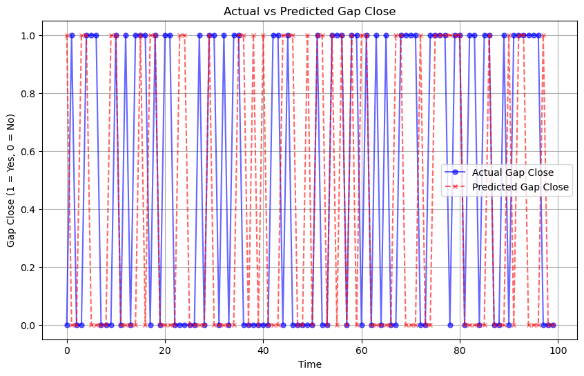
Actual vs Predicted Results

Slide 10
Training and Validation Accuracy
Model Performance:
Training Accuracy: Improves steadily as the model learns patterns from the data.
Validation Accuracy: Shows fluctuations but aligns with training accuracy over time, indicating good generalization.
Key Observations:
Improved accuracy over 40 epochs.
Some fluctuations in validation accuracy but overall trend is positive.

Slide 11
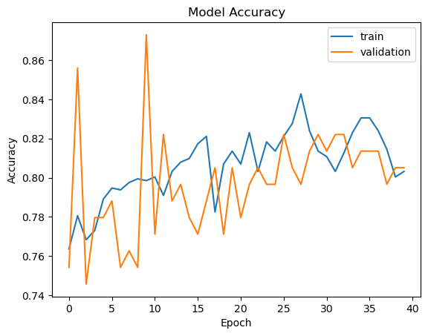
Training and Validation Accuracy
The graph shows the improvement in both training and validation accuracy over 40 epochs, highlighting effective model performance.

Slide 12
Confusion Matrix
Gap Close (1) vs No Gap Close (0):
The matrix shows how well the model classified these two categories.
It highlights true positives (correct gap close predictions) and true negatives correct no gap close predictions).
Key Findings:
Precision: Indicates how many of the predicted gap closes were actually correct.
Recall: Measures the model’s ability to identify all actual gap closes.
F1-Score: A balanced score between precision and recall, reflecting the model’s overall performance.

Slide 13
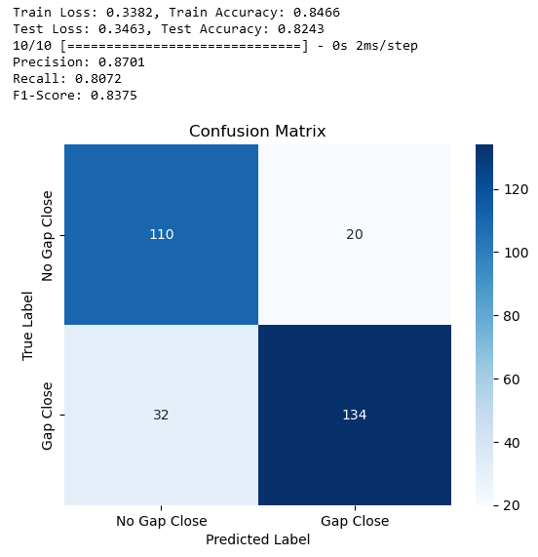
Confusion Matrix
The confusion matrix illustrates the model’s ability to correctly classify gap closes and no gap closes, showing the distribution of correct and incorrect predictions.

Slide 14
Challenges & Limitations
Challenges:
Hyperparameter Tuning: Finding the optimal parameters was time-consuming and required extensive experimentation.
Data Complexity: The financial data was highly volatile and unpredictable, making it difficult for models to consistently perform well across all scenarios.
Limitations:
Overfitting: Despite early stopping, some overfitting was observed, especially when models were trained for longer periods.
Data Dependency: The models rely heavily on historical data, which may not always accurately reflect future market behavior.
Computation: Training deep learning models on large datasets required significant computational resources, limiting experimentation with more complex models.

Slide 15
Conclusion
Key Takeaways:
Model Performance: The model successfully predicted stock price gaps for AAPL, showing its effectiveness for time series forecasting in financial markets.
Prediction Accuracy: The model demonstrated strong performance, especially for short-term gap predictions with an accuracy of 82.43%.
Real-World Impact:
Accurate gap prediction using GRU model can help traders optimize their strategies, reduce risks, and take advantage of market opportunities.
The GRU model’s approach could be extended to other stocks or financial assets for broader market insights.

Slide 16



Expanding the Model
Enhancing the Model
Apply to Other Stocks: Test the GRU model on different stocks and asset classes to evaluate its generalizability.
Incorporate More Features: Add additional features like news sentiment, macroeconomic indicators, or social media trends to improve model accuracy.
Hyperparameter Optimization: Further fine-tuning of GRU model parameters for even better performance.
Advanced Models: Explore more sophisticated deep learning models, such as Transformers, to handle more complex patterns in stock data.
Future challenges
Risk Management
Handling Market Volatility
Practical Use in Trading: Implement the model in real-time trading systems to evaluate its effectiveness in live market conditions.
Robustness Against Market Shocks: Incorporate methods to improve the model's robustness during periods of high volatility, such as during earnings reports or major market news.

Slide 17
Presented by Pranay Ulhas
Thank you very much!

